Slide 1



SHIELD INSURANCE
REPORT
Presented by:
Priya Jangid

Slide 2
AGENDA
Company Introduction
Problem Statement
Objective
Dashboard
Insights & Recommendations

Slide 3

ABOUT
SHIELD INSURANCE
Shield Insurance is a trusted insurance provider offering a wide range of insurance policies tailored for all age groups.
With a strong focus on customer satisfaction, the company is committed to delivering reliable coverage, personalized service, and protection at every stage of life.

Slide 4

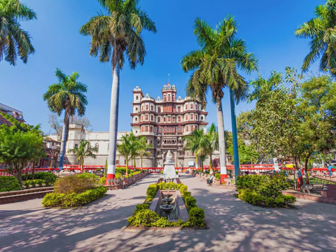


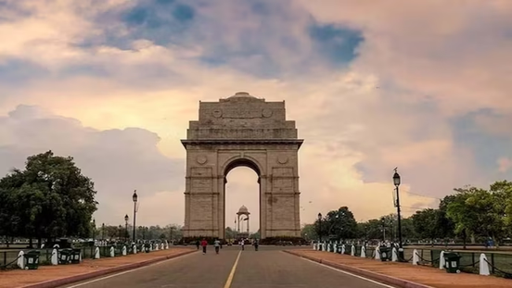
REGIONAL PRESENCE
MUMBAI
INDORE
HYDERABAD
CHENNAI
DELHI - NCR

Slide 5

MULTICHANNEL SALES STRATEGY
OFFLINE - DIRECT
ONLINE - APP
OFFLINE - AGENT
ONLINE - WEBSITE

Slide 6
PROBLEM STATEMENT
OBJECTIVE
Shield Insurance aims to leverage its data more effectively to drive data-informed decision-making and enhance overall business strategy.
As a Data Analyst Intern at AtliQ Technologies, my role is to analyze Shield Insurance’s data and deliver actionable insights through an interactive and visually engaging Power BI dashboard.

Slide 7
DASHBOARD

Slide 8
INSIGHTS
Revenue Trends:
Highest revenue was generated in March 2023 (~₹263M).
Lowest revenue was in November 2022 (~₹132M).
City-Wise Performance:
Delhi NCR is the top revenue contributor, driven by a high customer base.
Indore lags behind due to fewer customers.
Age Group Preferences:
The 31–40 age group forms the largest customer base.
The 17–24 group has the small share of customers.

Slide 9
INSIGHTS
Sales Channel Insights:
Offline Agents remain the preferred mode, contributing ~55% to both revenue and customers.
Online channels are steadily growing, indicating a shift in customer behavior.
Policy Performance:
POL2005HEL generates the highest revenue, , despite a smaller user base, popular among 31–40 and 65+ age groups.
POL4321HEL has the largest customer base, mostly from the 17–40 age range-possibly due to more affordable pricing.

Slide 10
RECOMMENDATIONS
Capitalize on High-Performing Regions
Focus on Delhi-NCR with campaigns, exclusive policy bundles and loyalty programs - as this city is highest revenue contributor.
Indore needs a boost - consider local campaigns to raise awareness, highlight best-selling policies or offer first-time buyer discounts to expand the customer base.
Strengthen Digital Channels
Improve the app and website experience - make it faster, easier, and more user-friendly.
Try digital-exclusive offers (e.g. lower premiums or cashback) to further encourage users to switch to online channels.

Slide 11
RECOMMENDATIONS
Age-Based Strategy
Focus on 31–40 age group with bundled plans (e.g. health + term), use testimonials of real users from this age group to increase trust.
For 17–30 age group, run awareness programs through social media platforms .
Leverage Policy-Specific Insights
POL2005HEL has high revenue with a small user base - introduce flexible premium versions or EMI-based options to attract more buyers.
POL4321HEL, with the highest user base, add small upgrades or extras to this plan so increase per user revenue.

Slide 12
THANK YOU

